Slide 1
An introduction to Apprenticeships for students
Notes:
My name is ‘insert name’ and I’m here on behalf of the National Apprenticeship Service to talk to you about apprenticeships.
It’s really important to remember to keep your options open about your future. So for the next 20 minutes, I’m going to explain: - The range of apprenticeship job roles available - The different levels - How you find an apprenticeship and - What you need to do next to start searching and applying
What we’re going to cover today is really important because even if you do already know what you’re planning to do when you leave school – plans can change. You need to keep your options open, have a plan A and a plan B and make sure that you really know what is out there.
Regardless of your background, there are apprenticeships for everyone. Employers tell us that they are always looking for a diverse workforce, they are looking for a mix of people to fill different job roles at different levels.
Lots of people will say ‘If you’re academic, you should go to university’ but this is a really old fashioned idea.
Through apprenticeships you could now potentially achieve a degree, if you wanted to, but I’ll tell you more about that in a few minutes.
Notes to presenter: Activity idea
Before I start, hands up who knows what an apprenticeship is?
(typical response is to get around 20% of the audience with their hands raised)
Ok – well hopefully when I ask you that again at the end of this session, everyone’s hands will be up in the air.

Slide 2
What are apprenticeships?
Earn a wage
Work for at least
30 hours per week
Study towards a
job related qualification
Contract of employment
including holiday pay
Real job with real responsibilities
Notes:
Lots of people get confused about apprenticeships. That’s probably because they’ve been around for hundreds of years, but they’ve changed a lot in that time.
You will earn a wage – and it can be a really good salary too! We’ll talk more about money later on.
You will work for at least 30 hours per week and this will include paid time to complete your studies.
The employer will invest their time and money in helping you to gain qualifications and valuable new skills and experience. You will be given real responsibilities and expected to work hard, just like anyone else in the company.
You will also be supported by a training provider, who will help you achieve your qualifications and make sure you complete your apprenticeship.
Because it’s a proper job, you will also have a contract of employment, including holiday pay - exactly the same as any other member of staff.
It’s important to understand that an apprenticeship is a real job, with a real employer. You will spend time working alongside other people and learn from their experience. There’s a myth that apprenticeships are just like work experience, where you’re given basic tasks or asked to make the tea, but this isn’t the case.
An apprenticeship typically takes 1 to 4 years to complete (sometimes up to 6 for some areas like Solicitor). The total duration will depend on the delivery model that your employer selects, the level and the subject you’re studying. As a minimum, all apprenticeships must last for a minimum of 12 months.
It’s important to remember that apprenticeships aren’t the ‘easy option’. Holding down a full time job and studying takes a certain skill, and it won’t be right for everyone.

Slide 3
The truth about apprenticeships
EARN A
GAIN A
SALARY
DEGREE
90%
NO FEES
STAY IN
WORK
TO PAY
POST-APPRENTICESHIP
YOU CAN
Social life?
RELOCATE
Notes:
Presenter notes: Ask the audience a question: Does anyone know what apprentices are paid? (Typically you will get lots of different responses)
The first thing to remember is that as an apprentice, you get paid a salary.
Many people think that apprentices are low-paid, and this can be true, depending on the employer. Legally, an employer must pay an apprentice the National Minimum Wage for apprentices which is currently £3.90 per hour. This is lower than the normal National Minimum Wage, but it recognises that some people will be going into their first job with no experience at all.
The good news is that lots of employers pay a lot more than the National Minimum Wage for apprentices.
Some apprenticeship schemes in big organisations have a starting salaries of £15k. And some London based employers will pay even more than this.
Presenter notes: You might want to display local opportunity pay rates or need to adjust this message depending on the local area.
It’s important to remember that if you see an apprenticeship you’re interested in, don’t be put off by the pay if it’s low: there’s room for progression and working your way to the top of an organisation.
Another common myth is that once you’ve completed your apprenticeship, your employer will let you go. This isn’t true. The majority of apprentices (around 90%) stay in employment. If they do change companies, it’s usually because they’re able to compete for a better job, perhaps with more pay or more responsibility.
Lots of young people are worried that as an apprentice you won’t get to have fun or meet other young people. That isn’t true. Depending on the size of the company, you may find yourself working with lots of other young people. You can join the Young Apprentice Ambassadors programme and you will meet hundreds of other apprentices.
Another myth is that apprenticeships are only for people that don’t go on to full time uni. That’s not true – there are different levels of apprenticeships suited to everyone and you can go all the way up to degree level – so you’re still at uni but part time. I’ll tell you more about that later.
One of the best things about apprenticeships is that they are everywhere. So if you want to carry on living at home then you can, but you can sometimes move around the country with an apprenticeship. It’s really important to do your research – but some companies will help you to relocate to work for them.

Slide 4
The range of apprenticeships
Accounting
Aviation
Horticulture
Architect
Creative & Digital
Teaching
Cyber Security
Surveying
Project management
Nursing
Dental Nursing
Hospitality
Hairdressing
Legal Services
Journalism
And many more….
Notes:
When we talk about apprenticeships, people often start to think of Plumbing, Electrical and some of the other construction trades. There are many brilliant apprenticeships in these areas, but there are also hundreds of new apprenticeships in exciting areas that you might not know exist.
The range of apprenticeship job roles out there is amazing
This slide gives you an idea of the huge range of apprenticeships available and this is just a taster
You could start an apprenticeship in hundreds of occupational areas. Some will amaze you!
Presenter notes: Depending on the time available…
Activity idea: Pick out a few of the job roles to discuss – will depend on the audience.
Activity idea: Can anyone spot an apprenticeship on the screen that has surprised them?
Activity idea: Does anyone know someone who is doing an interesting apprenticeship?

Slide 5
Which employers offer apprenticeships?
Notes:
Presenter notes: Please update this slide with local companies if you feel that the logos are not representative of your area
Equally, the range of employers offering apprenticeships is incredible.
This slide shows you some really familiar logos of big companies in England who all recruit apprentices.
Around 50% of apprenticeships started are with large companies like this, but 50% will be with smaller local companies.
It can be tempting to think that the ‘best’ apprenticeships are just with the big, well-known companies, but many of the smaller employers have absolutely brilliant schemes that enable fast-track career progression for their apprentices so it’s really important to do your research and not to ignore smaller employers because they can be just as good.
An example of a small local company is…X who employs apprentices in job roles like X and X etc. Presenter notes: Please include an example of a local company in the town that you are delivering in.

Slide 6
Look inside the company!
Logistics
IT and Cyber Security
Data Analytics
Sales
Business Development
Marketing
Human Resources (HR)
Finance
Legal
Facilities Management
Security
Customer Service
Training and Development
Notes:
You also need to think about the different roles that a company might have.
For example, if you want to work in finance – you shouldn’t just look at the big finance and accountancy companies. Lots of other companies will have their own in-house finance departments where you will still have access to a huge range of experiences and opportunities.
It can be a good idea to take some time to look at the different departments that a company has and see if they offer an apprenticeship in that area.
For example, you could work as a solicitor for Coca-Cola, a website designer for Vauxhall, as a Cyber Security apprentice for the Government. There are thousands of different opportunities!
Presenter notes: Please update the example if you feel that mentioning Vauxhall or Coca-Cola are not representative of your area.

Slide 7
The levels of apprenticeships
LEVEL
LEVEL
Intermediate
apprenticeship
Level 2
Advanced apprenticeship
Level 3
Higher apprenticeship
Level 4-7
Degree apprenticeship
Level 6 & 7
Intermediate
apprenticeship
Level 2
Advanced apprenticeship
Level 3
Higher apprenticeship
Level 4-7
Degree apprenticeship
Level 6 & 7
SKILLS, KNOWLEDGE & BEHAVIOURS
SKILLS, KNOWLEDGE & BEHAVIOURS
Notes:
We now have four apprenticeship levels: Intermediate, Advanced, Higher and degree.
If you want to, you can now start an apprenticeship with the potential to work all the way up to achieving a degree.
Higher apprenticeships cover all levels from 4 through to 7
Level 4, 5, 6 and 7 are equivalent to a Foundation Degree and above.
A degree apprenticeship contains a Level 6 or 7 Bachelors or Masters degree.
The level of apprenticeship you start at will depend on the kind of job that you are applying for. It’s really important not to be held back by only looking for a particular level e.g. degree apprenticeships, because it may be that you need to start at advanced or higher level and work your way up. Doing a job is completely different to getting a GCSE or A Level and that’s why it can be a bit confusing.
Keep an open mind so that you can explore all of the opportunities available

Slide 8
Different delivery models
Workplace learning
Online learning
20% of your paid time for off-the-job
learning
Classroom learning
Attend college or training provider
Notes:
There are many different ways an apprenticeship can be delivered.
It will differ, depending on the organisation and also the training provider delivering the apprenticeship.
For some apprenticeships, off-the-job learning is delivered at work. This means a tutor will come to you to teach you independently at work.
Another method of delivery is attending college or a local training provider. You might attend once a fortnight or once a week with other apprentices who work for other companies in the local area.
You may also find that you will carry out some learning through online learning.
Presenter notes: Please update this slide with local examples if you know of any. E.g. For example, apprentices who work for X will learn by attending X for X days/weeks etc.

Slide 9
How do apprenticeships compare to full time university?
HIGHER AND DEGREE
APPRENTICESHIPS
Work full time and study part-time
100+ UNIVERSITIES
Learning
Salary
No Debt
NUS
Experience
4-6 Years
University fees paid by employer and/or government
Notes:
Presenter notes: Is this slide appropriate for your audience today?
Higher and degree apprenticeships are a real alternative to following the traditional route of going to University as a full time student.
They offer all the benefits of higher education with none of the cost. You will not only be learning, but earning a salary, from day one. With a degree apprenticeship, you’re much less likely to build up any debt. Your tuition fees are paid for by your employer and the Government, so you will not be expected to pay £9000 a year.
More than 100 Universities in England offer degree apprenticeships now
The students on degree apprenticeships are entitled to exactly the same as other students, so you will still have access to the student union, sports facilities, clubs, societies and student discounts.
In the past, going to university was seen as the best way to advance your career to a higher level. But with the current level of competition for jobs amongst graduates, it might not be the best route for you. With an apprenticeship, you gain the competitive advantage of gaining at least 3 years’ work experience whilst completing your degree.
But remember – it’s hard work as a degree apprentice. You’ll be working full time and fitting in the equivalent of a full time degree alongside it. It might take a bit longer than studying full time – for example, 4 years instead of 3, but you’ll achieve exactly the same degree.
No matter what kind of career you want to follow, you need to do your research and find out if there’s a way to get to the role you want through an apprenticeship. That way, you can decide if you would prefer to study full time at college or university, or if you would prefer to go into work as an apprentice and gain qualifications and experience on the job from day 1.
Remember, you can apply for apprenticeships alongside applying for university and then you can decide what is right for you later on.

Slide 10
Are there any jobs? How many vacancies are near me?
28,000+ vacancies
In your area:
5 miles = 81 vacancies
10 miles = 237 vacancies
15 miles = 461 vacancies
20 miles = 743 vacancies
Notes:
Presenter notes: We would expect this slide to be updated by the delivery partner to reflect local opportunities by searching through Find an Apprenticeship
I had a look on the Find an apprenticeship website before coming along today so that I could see how many vacancies are out there at the moment.
As an example, I put my home postcode into the website and within 5 miles of my home postcode, there are xx vacancies.
You can see how this number grows the more you increase the distance.
You can do the same with your home postcode and see how many opportunities there are near you
You will need to think about how far you are prepared to travel for work each day.
If you want to think about working in the (insert name of an appropriate town/city), then you could be looking for vacancies there.
The one rule is that you will need to be able to get there, on time, every day.
Remember, it is important not to restrict your searches for vacancies to just look at large companies as many small employers offer some excellent vacancies with great packages and career progression opportunities.

Slide 11
Apprenticeship jobs in the local area
Job opportunity | Level | Closing date | Weekly salary
Dental Nurse Apprentice | Level 3 (Advanced) | 30 Jun 2020 | £124.50
Apprentice Sales Administrator | Level 2 (Intermediate) | 11 Aug 2020 | £153.55
Travel Consultant Apprenticeship | Level 3 (Advanced) | 31 Jul 2020 | £8,121.00 annually
Apprentice Digital Marketing Assistant | Level 3 (Advanced) | 31 Jul 2020 | £145.25
Apprentice Customer Service Assistant | Level 2 (Intermediate) | 31 Jun 2020 | £145.25
Arborist Apprentice | Level 2 (Intermediate) | 2 Aug 2020 | £166.00
Notes:
Presenter notes: Please update this slide with relevant examples for your audience
Search through Find an apprenticeship using the establishment postcode and find some interesting jobs.
Try to find a selection of closing dates so that you can reinforce the need to be using Find an apprenticeship regularly
Try to find a range of salaries so that you can show that there are employers who are prepared to pay more
Try to find a job title that might sound a bit confusing and then explain what that role really is – make it sound exciting and explain that they should not be put off by the titles of some jobs, it’s important they read the job advert attached to it.
This slide shows a range of vacancies that I could find
You will notice that they all have different closing dates – this is one big different to applying for university
If you do see a closing date, it’s important that you don’t wait until the very end to submit your application. We are now finding from talking to employers, if they receive a huge number of applications, they may decide to close the application window early.
You will also notice the range of different salaries too – this is because employers can decide what to pay (as long as it meets the national minimum wage for apprentices of £3.90)

Slide 12
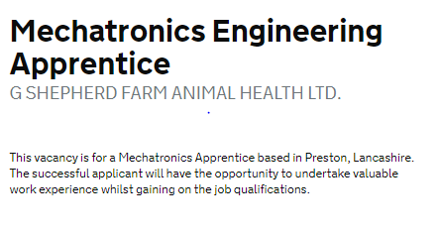
Find an Apprenticeship vacancy
WHERE ELSE TO LOOK?
Notes:
Whilst Find an apprenticeship is a great place to start looking for apprenticeships, it is not the only place.
If you have a particular employer in mind, visit their website and see if you can sign up for recruitment alerts or if they send out a newsletter.
Make sure you follow their careers pages on social media using facebook, twitter and Instagram too as they will probably use this as a way to promote their vacancies.
There are lots of other job search sites out there, so spend some time on the internet searching for apprenticeship vacancies. There will be a real mix from your local council who might have a jobs page for young people, through to bigger recruitment sites too.
We have spoken to lots of apprentices and quite often, they will say that they actually heard about their job through a family member or friend. So make sure you tell everyone you can think of that you’re looking for an apprenticeship and you never know what might come through!

Slide 13
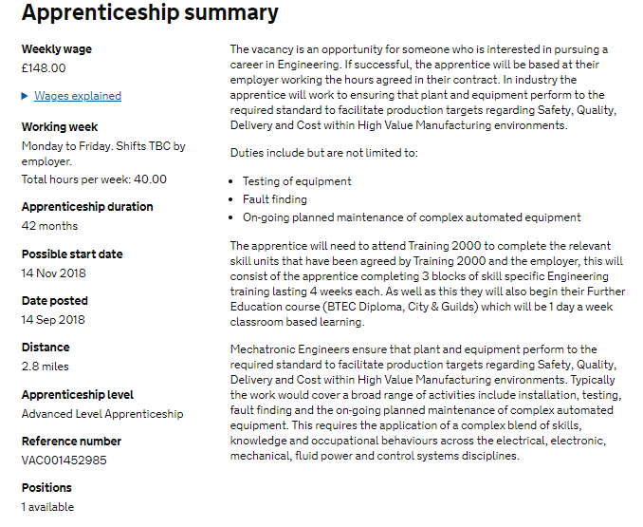
Do some research!!
WHERE ELSE TO LOOK?
Notes:
Whilst Find an apprenticeship is a great place to start looking for apprenticeships, it is not the only place.
If you have a particular employer in mind, visit their website and see if you can sign up for recruitment alerts or if they send out a newsletter.
Make sure you follow their careers pages on social media using facebook, twitter and Instagram too as they will probably use this as a way to promote their vacancies.
There are lots of other job search sites out there, so spend some time on the internet searching for apprenticeship vacancies. There will be a real mix from your local council who might have a jobs page for young people, through to bigger recruitment sites too.
We have spoken to lots of apprentices and quite often, they will say that they actually heard about their job through a family member or friend. So make sure you tell everyone you can think of that you’re looking for an apprenticeship and you never know what might come through!

Slide 14
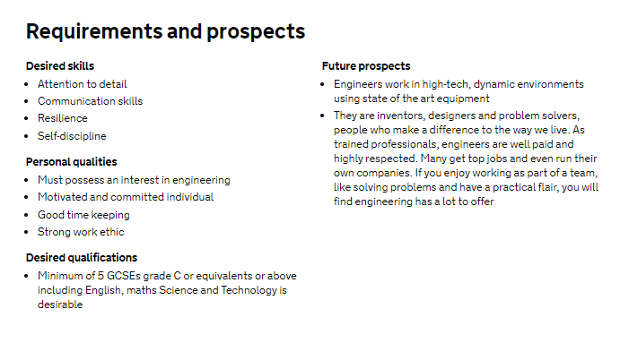
Do some research!!
WHERE ELSE TO LOOK?
Notes:
Whilst Find an apprenticeship is a great place to start looking for apprenticeships, it is not the only place.
If you have a particular employer in mind, visit their website and see if you can sign up for recruitment alerts or if they send out a newsletter.
Make sure you follow their careers pages on social media using facebook, twitter and Instagram too as they will probably use this as a way to promote their vacancies.
There are lots of other job search sites out there, so spend some time on the internet searching for apprenticeship vacancies. There will be a real mix from your local council who might have a jobs page for young people, through to bigger recruitment sites too.
We have spoken to lots of apprentices and quite often, they will say that they actually heard about their job through a family member or friend. So make sure you tell everyone you can think of that you’re looking for an apprenticeship and you never know what might come through!

Slide 15
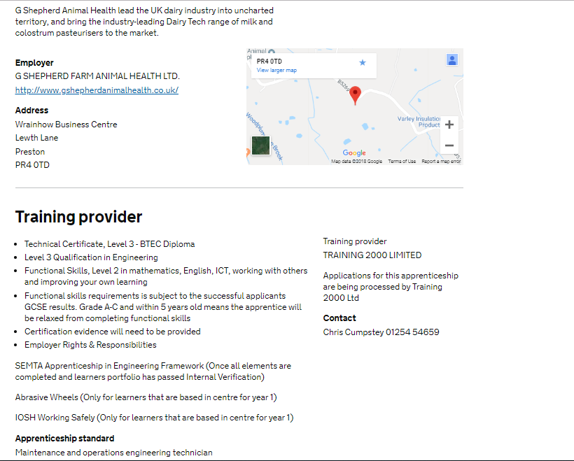
Do some research!!
WHERE ELSE TO LOOK?
Notes:
Whilst Find an apprenticeship is a great place to start looking for apprenticeships, it is not the only place.
If you have a particular employer in mind, visit their website and see if you can sign up for recruitment alerts or if they send out a newsletter.
Make sure you follow their careers pages on social media using facebook, twitter and Instagram too as they will probably use this as a way to promote their vacancies.
There are lots of other job search sites out there, so spend some time on the internet searching for apprenticeship vacancies. There will be a real mix from your local council who might have a jobs page for young people, through to bigger recruitment sites too.
We have spoken to lots of apprentices and quite often, they will say that they actually heard about their job through a family member or friend. So make sure you tell everyone you can think of that you’re looking for an apprenticeship and you never know what might come through!

Slide 16
Do some research!!
It is essential to research the organisation you are applying to
Your research and effort will be obvious to the employer in your interview
Vacancy snapshot
https://amazingapprenticeships.com/vacancies/
Employer Overview
Programme Details
Behind the Scenes
Application Hints and Tips
More information..
Notes:
Whilst Find an apprenticeship is a great place to start looking for apprenticeships, it is not the only place.
If you have a particular employer in mind, visit their website and see if you can sign up for recruitment alerts or if they send out a newsletter.
Make sure you follow their careers pages on social media using facebook, twitter and Instagram too as they will probably use this as a way to promote their vacancies.
There are lots of other job search sites out there, so spend some time on the internet searching for apprenticeship vacancies. There will be a real mix from your local council who might have a jobs page for young people, through to bigger recruitment sites too.
We have spoken to lots of apprentices and quite often, they will say that they actually heard about their job through a family member or friend. So make sure you tell everyone you can think of that you’re looking for an apprenticeship and you never know what might come through!

Slide 17
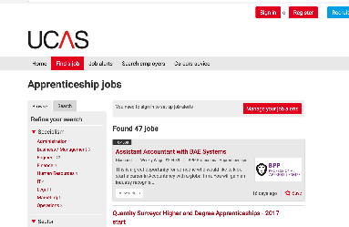
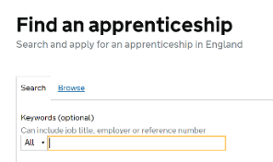
How do you find an apprenticeship?
1
4
Register on Find an apprenticeship
Manage
your alerts
2
5
Do your
research
Contact
companies
3
To find an apprenticeship visit
GOV.UK and search for apprenticeships
Search
and apply
Notes:
1. It’s really important to register with Find an Apprenticeship. Search the internet for ‘Find an apprenticeship’ and it will come up as the first link The search page is on gov.uk, an official government site Once you register you’ll receive an account activation code by email. After activating your account, you’re ready to start applying for apprenticeship vacancies.
2. Have a look at the different jobs that are being advertised. Remember, this is a live jobs site so it may be that you need to try and few different searches or to broaden how far you are looking to find jobs that you are interested in.
3. Start applying for jobs that interest you. You need to remember that some of the bigger companies will advertise quite early in the year (e.g. Autumn) for apprentices to start the following September so please don’t leave it until the last minute or you might be disappointed to have missed a great opportunity.
4. Set up your alerts. A great feature of this system is that you can get it to do all the hard work for you. You can manage your alert settings so that you receive text messages and emails when jobs come up that you might be interested in
5. Employers are always telling us that the applicants that really stand out to them, are those that have made a bit of extra effort. You could consider contacting the company and asking them if you could spend a few hours shadowing a member of staff or if they have any open days coming up. That will look really impressive on your application and can give you an advantage over other applicants.

Slide 18
Your local College, Training Provider and University
https://www.lancsforum.co.uk/contact-details
Notes:
Don’t forget that the local colleges, training providers and universities can help you find an apprenticeship and are still available for any questions and applications
Contact details for all the colleges, training providers and universities can be found on their websites or by following this link
OR you can click on any of the icons on the slide and you will be taken directly to their website

Slide 19
Where else to look?
https://www.lancsforum.co.uk/sorted
Notes:
There is also a handy tool called SORTED which you might have already seen in your careers office at school. This lists all the Lancashire Colleges, Training Providers and Universities and gives you details of the Apprenticeship opportunities they can help you find. You can find SORTED by following this link or clicking on the icon

Slide 20
Where else to look?
WHERE ELSE TO LOOK?
Social media
Your friends and family
The company website
Notes:
Whilst Find an apprenticeship is a great place to start looking for apprenticeships, it is not the only place.
If you have a particular employer in mind, visit their website and see if you can sign up for recruitment alerts or if they send out a newsletter.
Make sure you follow their careers pages on social media using facebook, twitter and Instagram too as they will probably use this as a way to promote their vacancies.
We have spoken to lots of apprentices and quite often, they will say that they actually heard about their job through a family member or friend. So make sure you tell everyone you can think of that you’re looking for an apprenticeship and you never know what might come through!
There are lots of other job search sites out there, including Vacancy Snapshot where you can flick through online interactive profiles for some of the UK’s top apprentice employers
Definitely spend some time looking into the different types of employers. There will be a real mix from your local council who might have a jobs page for young people, through to bigger recruitment sites too.

Slide 21
Online Resources
https://amazingapprenticeships.com/student-apprenticeship-guide
https://amazingapprenticeships.com/resources/
Notes:
The Amazing Apprenticeship website has some fantastic interactive resources for all year groups that you can download to help you over the next few weeks and months

Slide 22
Contact us
Follow the National Apprenticeship Service: @Apprenticeships
Fireitupapps
National Apprenticeship Service
Search for apprenticeships on GOV.UK or call 08000 150 400
Notes:
My main message to you today is no-matter what your first choice is, whether it is studying at university full time or applying for apprenticeships, it’s really important to keep your options and do your research.
Apply for university or colleges and look at apprenticeships and submit applications.
You may change your mind further down the line so our advice to you is to apply for both – that way when you get your results, you will have some options.
Presenter notes:
Hand out apprenticeship collateral or close session

Slide 23
Any questions?
Notes:
Presenter notes
Activity idea: Offer a small box of chocolates / packet of sweets for whoever has the best question
Do you have any questions?

