Slide 1
GCSE Science
at Central Lancaster High School

Slide 2
Science Options
Science is a core subject and so therefore must be studied by everyone.
However there is a choice between Combined Science (2 GCSEs) and Separate Science (3 GCSEs).
Understanding key scientific principles helps to explain the world around you and enables you to make informed decisions.

Slide 3
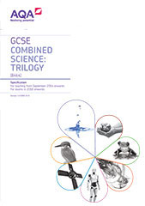
AQA Combined Science (Trilogy)
This covers the core scientific content required to study at KS4.
Students will be taught biology, chemistry and physics in separate lessons by subject specialists.

Slide 4
Content
Biology
Chemistry
Physics
Cells
Organisation
Infection and response
Bioenergetics
Homeostasis
Inheritance and evolution
Ecology
Atomic Structure
Bonding
Quantitative chemistry
Chemical change
Energy changes
Rates of reaction
Organic Chemistry
Chemical analysis
Atmosphere
Using resources
Energy
Electricity
Particle model
Radiation
Forces
Waves
Magnets

Slide 5
In year ten the students study all of the content required for the paper 1 examinations. The content for the paper 2 examinations is covered in year eleven.
Practical skills are assessed in the written examinations.
Assessment objectives
AO1: 40%
Demonstrate knowledge and understanding of:
Scientific ideas.
Scientific techniques and procedures.
AO2: 40%
Apply knowledge and understanding of:
1) Scientific enquiry, techniques and procedures.
AO3: 20%
Analyse information and ideas to:
1a) Interpret.
1b) Evaluate.
2a) Make judgements.
2b) Draw conclusions.
3a) Develop experimental procedures.
3b) Improve experimental procedures.

Slide 6
Assessment
At the end of Year 11 students will sit 6 exams each 1 hour 15 minutes long.
Each exam has equal weighting and will be worth 16.7% of the final grade.
These can be higher tier (grades 4-3 to 9-9) or foundation tier (grades 1-1 to 5-5).
Biology 1 (units 1-4), Biology 2 (units 5-7), Chemistry 1 (units 1-5), Chemistry 2 (units 6-10), Physics 1 (units 1-4) and Physics 2 (units 5-7).
Students will receive 2 GCSE grades that will be within 1 grade of each other e.g. 4-4, 5-4, 5-5

Slide 7
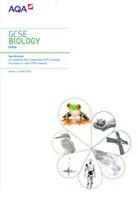
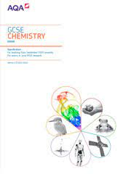
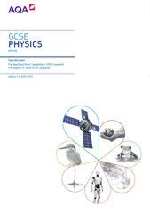
AQA Separate Sciences Biology, Chemistry and Physics
GCSE Separate Sciences offers students a chance to gain a more in depth knowledge of Chemistry, Biology and Physics and to build on areas covered in combined Science in more detail as well as covering extra content. This course is great preparation for studying Science at A level, under-graduate and post-graduate degree level.

Slide 8
Additional Content
Biology
Chemistry
Physics
Monoclonal antibodies (B3)
Plant diseases and defences (B3)
The brain (B5)
The eye (B5)
The kidneys (B5)
Plant hormones (B5)
Protein synthesis (B6)
History of genetics (B6)
Food security and farming (B7)
Biotechnology (B7)
Nanotechnology (C2)
Atom economy and percentage yield (C3)
Titrations (C4)
Fuel cells (C5)
Alkenes, alcohols, carboxylic acids (C7)
Polymers (C7)
Ion tests (C8)
Properties of materials (C10)
Haber process and fertilisers (C10)
Static electricity (P2)
Nuclear fission and fusion (P4)
Moments (P5)
Pressure (P5)
Sound waves and ultrasound (P6)
Earthquakes (P6)
Lenses (P6)
Generators, loudspeakers, microphones (P7)
Space (whole unit P8)

Slide 9
Assessment
At the end of Year 11 students will sit 2 exams for each science. All exams are 1 hour 45 minutes long and worth 50% of the final grade.
These can be higher tier (grades 4-9) or foundation tier (grades 1-5).
Biology 1 (units 1-4), Biology 2 (units 5-7), Chemistry 1 (units 1-5), Chemistry 2 (units 6-10), Physics 1 (units 1-4) and Physics 2 (units 5-8).
Students will receive 1 GCSE grade for each of the sciences.

Slide 10
Pathways post-16
Separate science courses can lead on to study at A-Level and beyond.
Careers in medicine, veterinary science, mechanical engineering, nursing, midwifery, child care, sports science, meteorology, architecture, chemical engineering and horticulture are accessible through successful completion of this course.

Slide 11
For more information about the course,
please speak to your child’s science teacher at progress evening on Thursday 14th March 2024 or you can contact me via email on amiddleton@lancasterhigh.lancs.sch.uk

