Slide 1
Music
at Central Lancaster High School

Slide 2
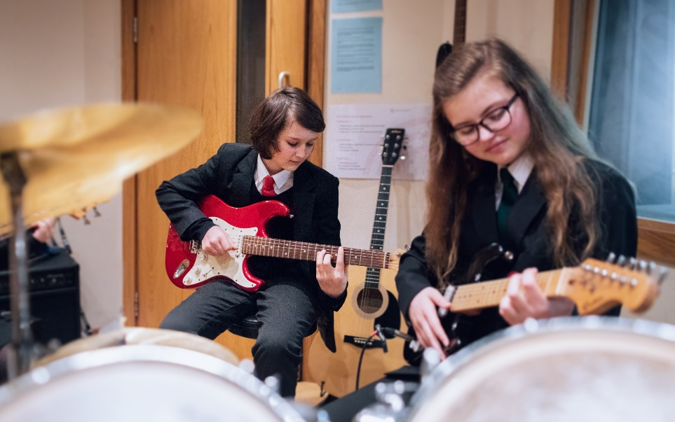
Why should I choose music?
Enjoyment of music
Developing instrumental skills
Develop skills for employment
Completely different to core subjects
60% coursework

Slide 3
What does the course involve?
The course is examined by Eduqas and is made up of 3 components:
Component 1 – Performing music (30% of the overall GCSE. 2 performances – 1 solo & 1 ensemble)
Component 2 – Composing music (30% of the overall GCSE, 2 compositions)
Component 3 – Appraising (40% of the overall GCSE, one final exam)

Slide 4
How is the work assessed?
Components 1 and 2 are assessed through non-exam internal coursework.
Component 3 – externally assessed (listening exam)

Slide 5
Internally assessed units
Component 1 – Performing
Component 2 - Composition
Any instrument including rapping, beatboxing and Djing.
One solo performance
One ensemble performance
Recorded through the year
Audio only
Between 3 – 6 minutes long
30% of GCSE
2 compositions
1 free choice – year 10
1 set by the exam board – 4 choices, year 11
Between 3 – 6 minutes long (combined)
30% of GCSE

Slide 6
Component 3 – Listening and appraising
4 areas of study:
AOS 1 – Music from the Western classical tradition 1650 – 1910 set work - J S Bach ‘Badinerie’.
AOS 2 – Music for ensemble – Chamber music, Jazz and Blues music, Musical Theatre.
AOS 3 – Film music – Soundtracks and sfx
AOS 4 – Popular music – Pop, Rock, Bhangra, Fusion. Set work – Toto ‘Africa’.

Slide 7
What skills will I develop?
Employers and universities are increasingly looking for well-rounded people who have academic and practical skills combined with real-world knowledge:
Communication
Confidence
Organisation
Independent learning
Problem solving
Research
Self-discipline
Time management

Slide 8
Pathways for post-16 study
Pupils can go onto a number of the local 6th form providers to study A’ Level Music and associated subjects
Alternatively local colleges offer full-time study in performing arts and music at level 2 and 3.
Post-18 students can progress to a wide range of degrees in the music at universities both nationally or internationally, or, they may choose to pursue an apprenticeship or go into employment.

Slide 9
For more information about the course,​
please speak to your child’s music teacher at progress evening on Thursday 14 March 2024.

