Slide 1
GCSE French and Spanish
at Central Lancaster High School

Slide 2
Why study French/Spanish GCSE?

Slide 3
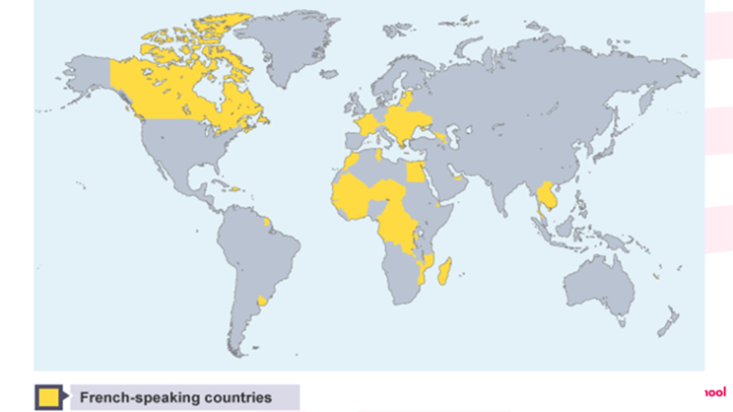
Benefits
Notes:
Average salary 10 to 15% higher with languages skills
Research has explored the benefits of foreign language learning on the brain!
Facilitating subjects are the subjects most commonly required or preferred by universities to get on to a range of degree courses. They help you keep your options open when choosing a degree, and many of the top universities will ask you to have at least one A-level in a facilitating subject when you apply.

Slide 4
Why study French/Spanish GCSE at Central Lancaster High School?

Slide 5
“Engaging”
“Inclusive”
“Interesting”
“Well-paced””
”Intriguing”
“Interactive”
We asked our students the best words to describe their lessons…
“Compelling””
“Fun””
“Commendable”
“Enjoyable”
“Challenging (in a good way)”

Slide 6
Exam board: Eduqas/AQA to be confirmed
Click here and here to access the French/Spanish GCSE pages.

Slide 7
Methods of assessment
What does the course involve?
Four assessments at the end of Year 11, each worth 25% of the final grade

Slide 8
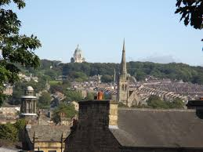
Overview
GCSE topics are:

Slide 9
Reading
Exam:
Foundation – 45 minutes
Higher – 60 minutes
Comprehension task
Multiple choice tasks
Translation into English

Slide 10
Writing
Exam:
Foundation – 70 minutes
Higher – 85 minutes
Short sentences production.
Translation into French
Describing a picture and writing 90 words

Slide 11
Speaking
A read-aloud task
A role-play task with a follow up short conversation
A photocard description and unprepared conversation
Exam:
Foundation - 7-9 minutes with 15 minutes of preparation
Higher - 10-12 minutes with 15 minutes preparation
Teacher tests student- recording sent to Exam Board

Slide 12
Listening
Exam:
Foundation -35 minutes
Higher - 45 minutes
Comprehension tasks
Dictation tasks

Slide 13
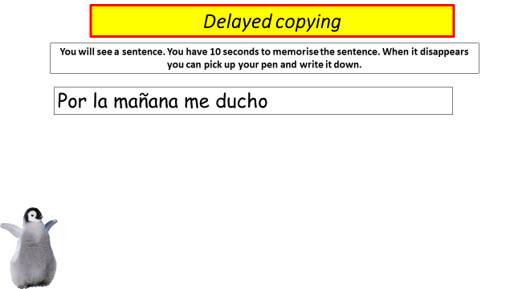
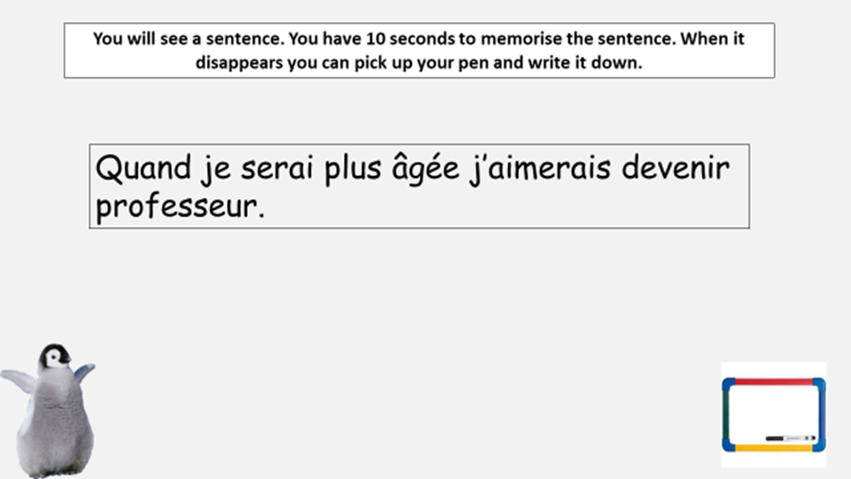
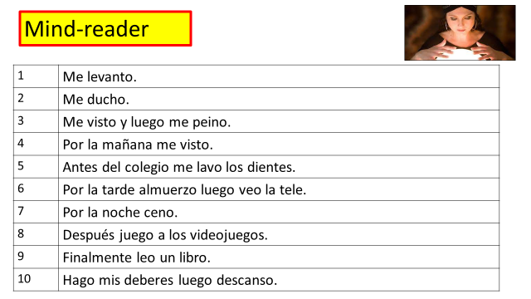
Mixing things up!

Slide 14
Pathways:
Sixth form and A-level, University Degree
Careers: A modern language provides skills that are highly in demand with recruiters in a wide range of industries, all around the world. Examples of careers where a language is in high demand are teaching, journalism, travel and tourism services, publishing, banking, the Armed Forces and marketing.

Slide 15
For more information about the course,
please speak to your child's French/Spanish teacher at progress evening on Thursday 14th March 2024.

