Slide 1
GCSE History
at Central Lancaster High School

Slide 2
“What’s the point in studying history?”
You will broaden your knowledge of the past in a manner that allows you to understand the world in which we live today.
The critical thinking skills such as analysis of cause, consequence, significance.
Develop your skills in using various forms of information.
Develop skills that allow you to identify, verify and evaluate different opinions.
Notes:
There are 4 key skills that we develop when studying History. Explain how the above are important life skills for both work and friendship.
In History they are referred to as Assessment Objectives (seen on the wall in D4 next to the door).
Knowledge 35%, Analysis 35%, Sources 15% and Interpretations 15%. Not all skills are on all of the papers and you will see this on your overview sheet that we will talk about next. In short, the most important thing is to know the stories and why they are important.

Slide 3
Your History GCSE overview
Your Personalised Learning Checklists (PLC)
Notes:
Explain the top box of exams and then the different questions (briefly) from the bottom. These sheets can be handed out on entry.
Explain the purpose of the PLC – to be clear about what needs to be known and then assess your confidence level with it. Parents can look at these too.

Slide 4
GCSE History (Edexcel)
Paper 1:
Crime and Punishment 1000 – Present
Notes:
We will go through each paper.
We do not study them in order, this paper is studied in Y11. We look at the easier skills and content first.

Slide 5
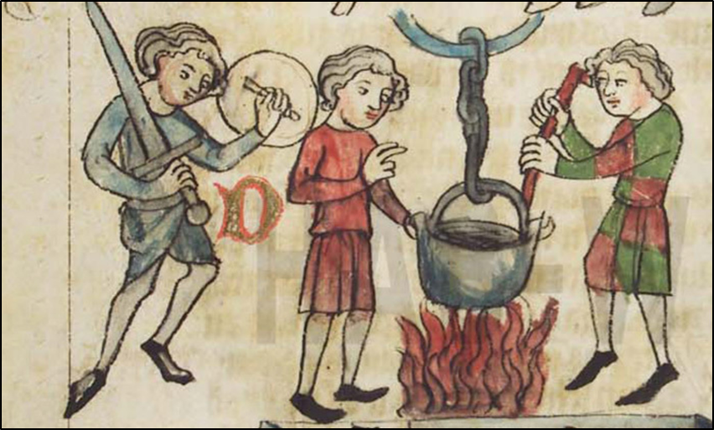
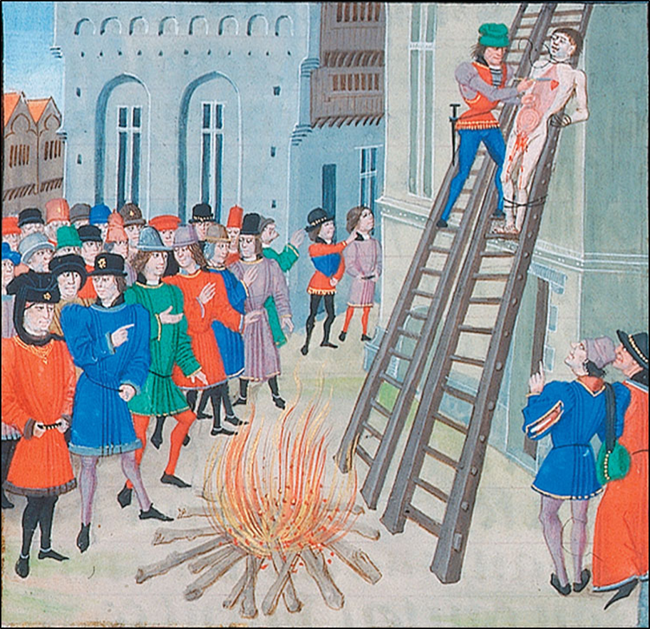
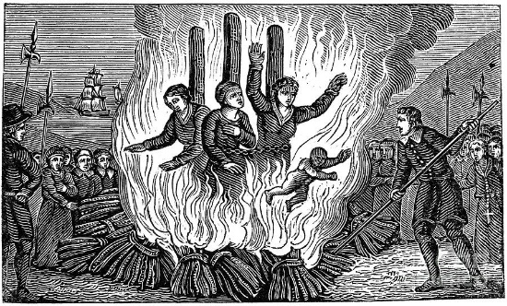
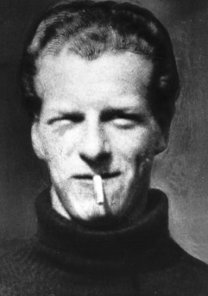
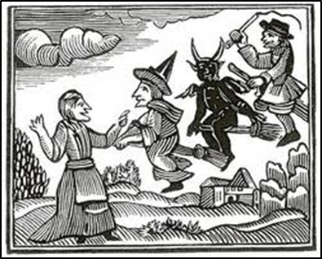
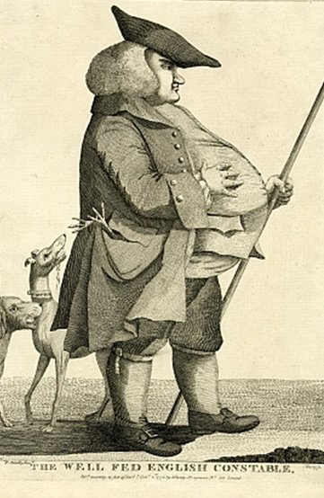
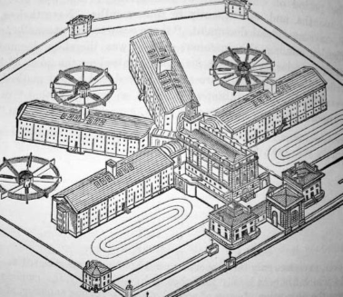
Notes:
Each picture comes up as a separate animation which you can use to give an outline of the unit.
1). Trial by ordeal – explain the process / theory.
2). Hanging drawing and quartering – why authorities wanted to make punishment such a public and awful things
3). Early modern period – burning witchcraft and the importance of religion driving the definition of crime and the involvement of the church in punishment.
4). Witchcraft then is treated as a non-crime, people are no longer afraid.
5). The introduction of Thief Takers, Town Constables and Nightwatchmen to enforce the law – trying to fill a gap after the growth of towns and the notion of collective responsibility cannot be employed as society becomes too big.
6). Pentonville – the first prisons, their purpose and success. The silent system, what prison used to be like.
7). The end of capital punishment in the UK – we look at three key cases and the picture is of Derek Bentley.

Slide 6
GCSE History (Edexcel)
Paper 2:
Norman Conquest and Cold War
Notes:
The first thing that we study in year 10 is the Anglo-Saxon / Norman paper

Slide 7
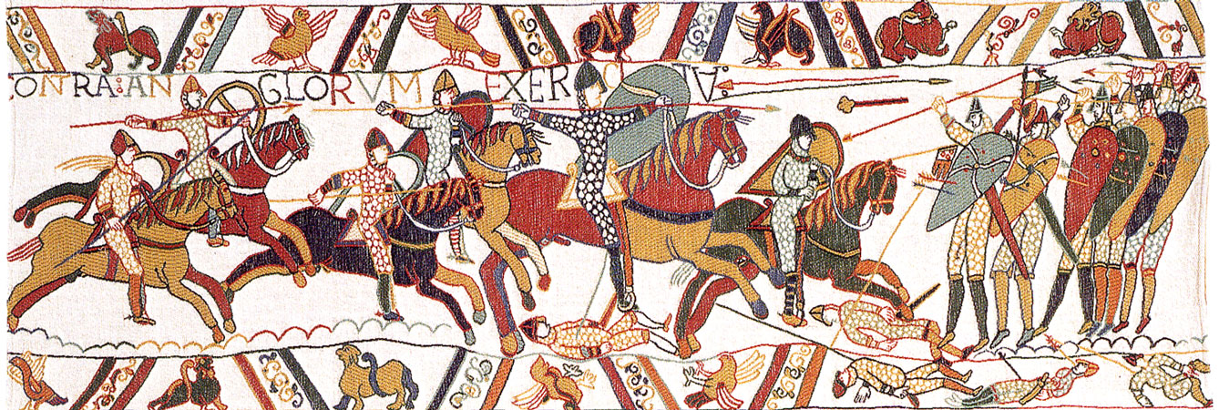
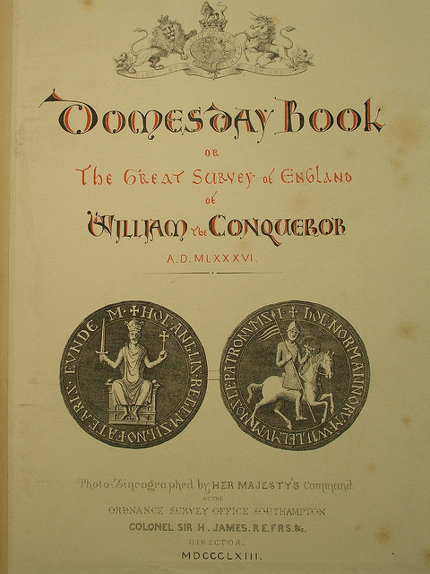
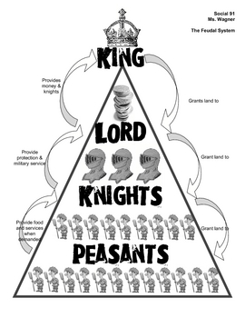
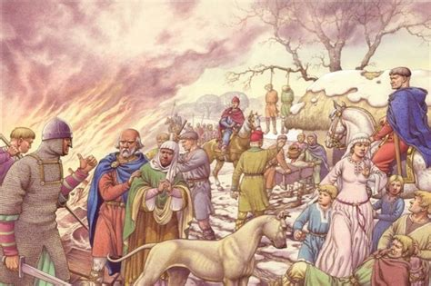
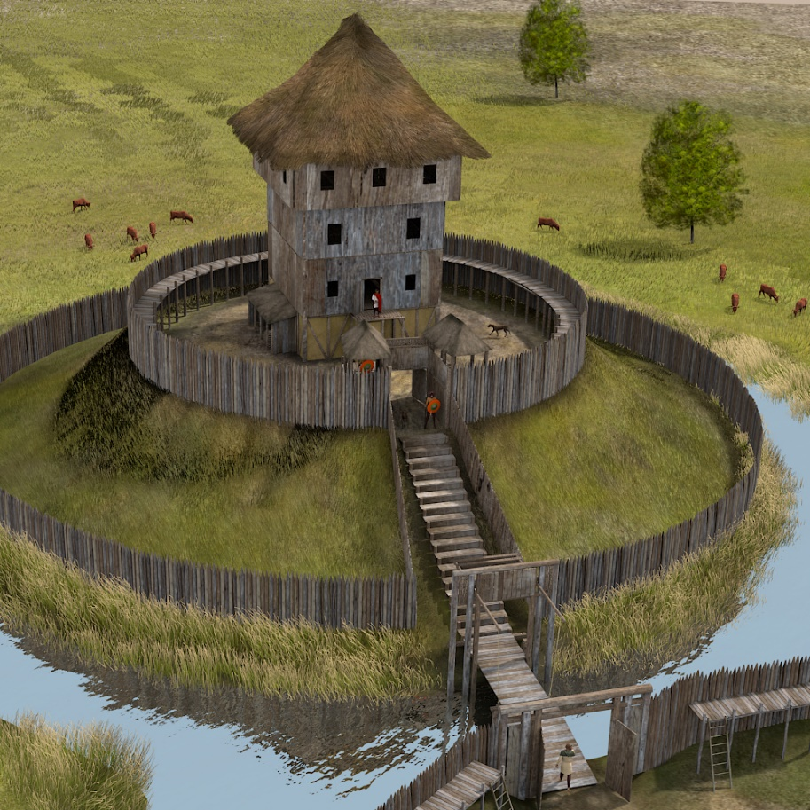
Notes:
This is quite a simple one as the pictures come up.
1). The Norman invasion – we start looking at Anglo-Saxon life and study in the invasion in detail.
2). Motte and Bailey Castles – the building project and impact.
3). Domesday Book – what it was and what was it’s impact
4). The Harrying of the North – what it was and why it was carried out.
5). The Feudal system – what it was and why it was a success.

Slide 8
GCSE History (Edexcel)
Paper 2:
Norman Conquest and Cold War
Notes:
We then then complete the paper 2 study by looking at the Cold War – something that many of us can remember and the generation of our parents lived through. This is particularly relevant now in helping us to understand the situation in Ukraine at the moment.

Slide 9
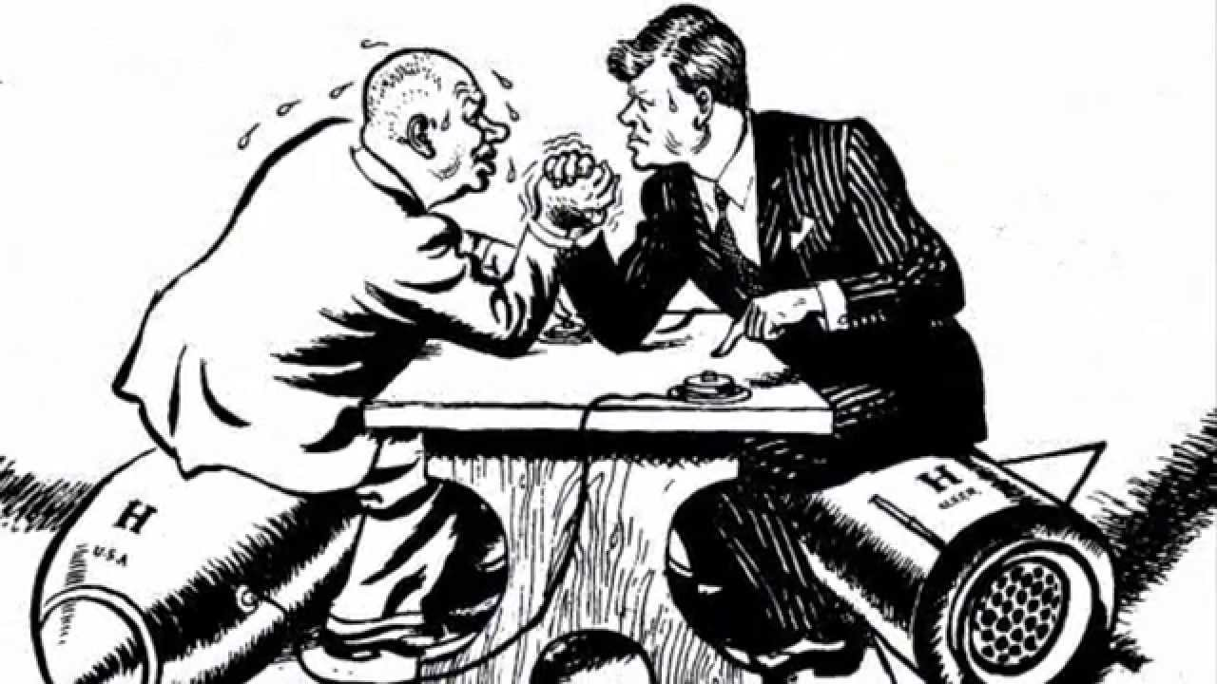
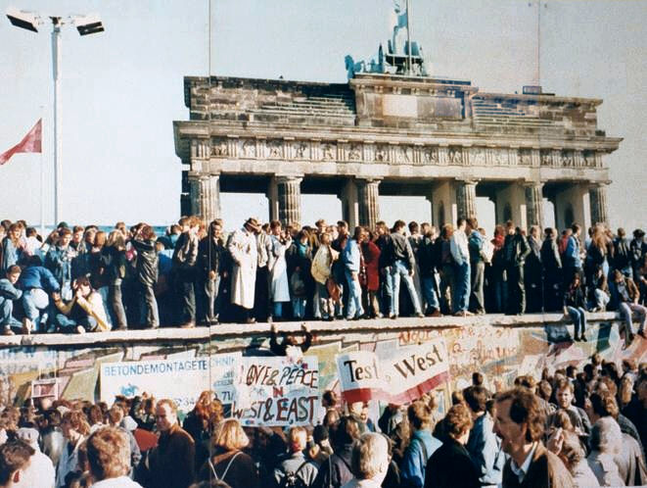
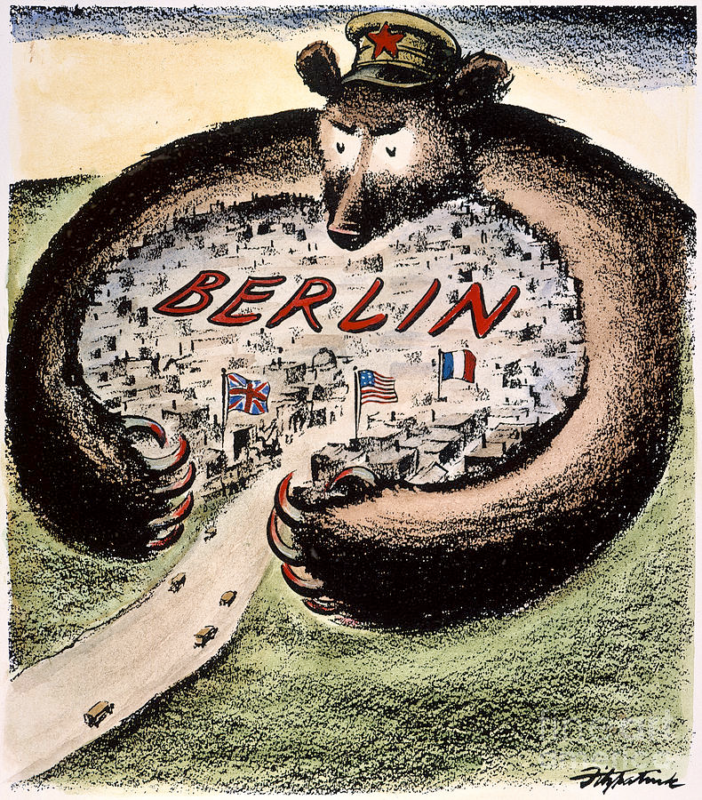
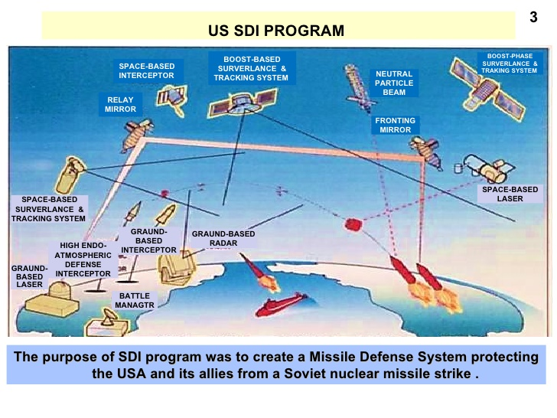
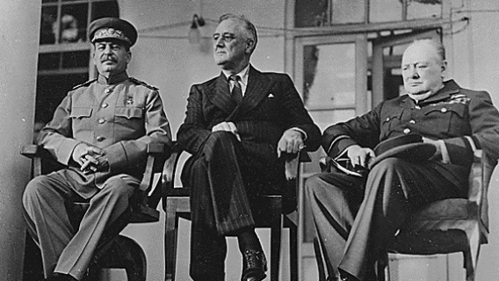
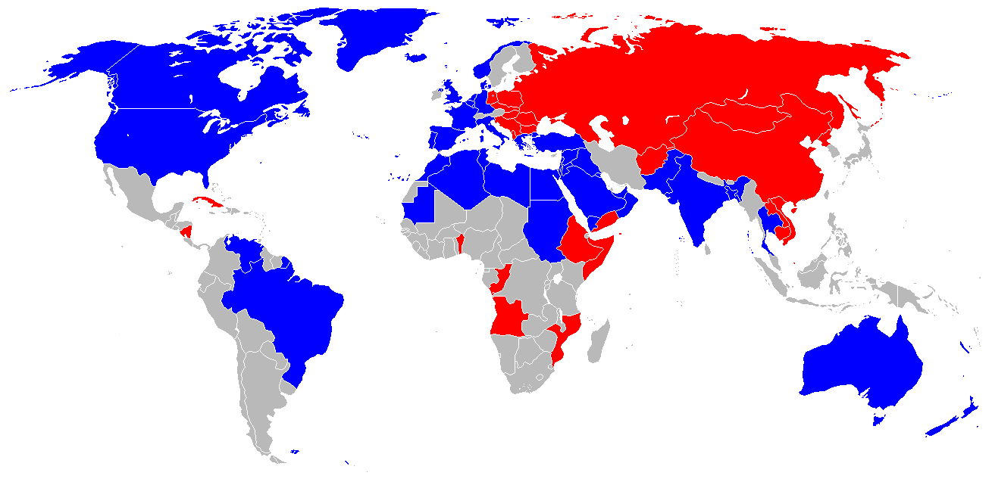
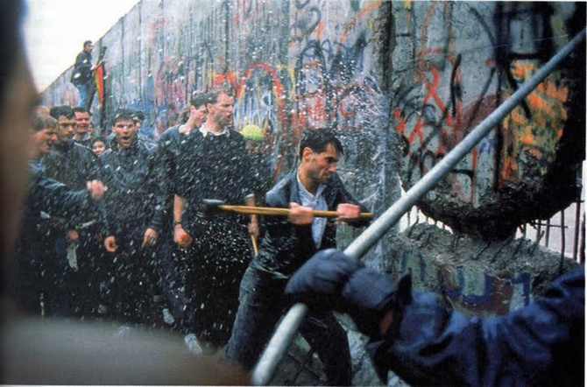
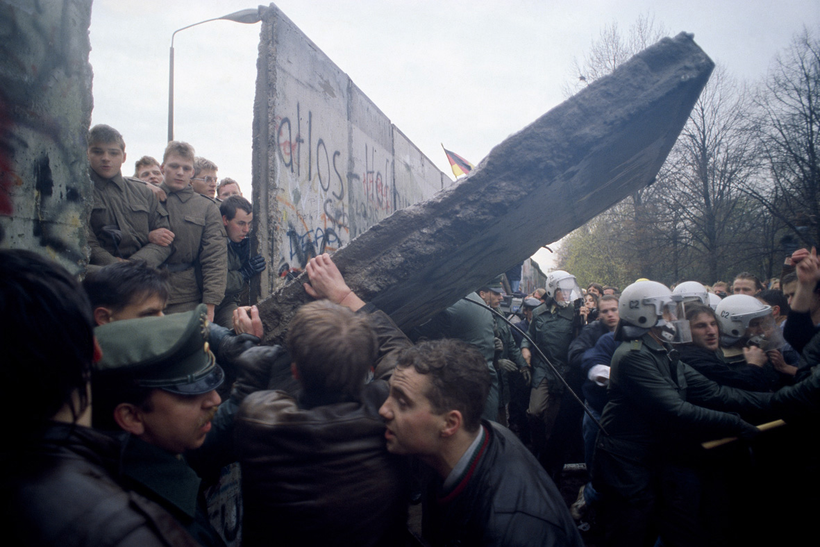
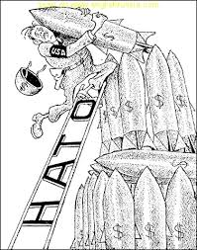
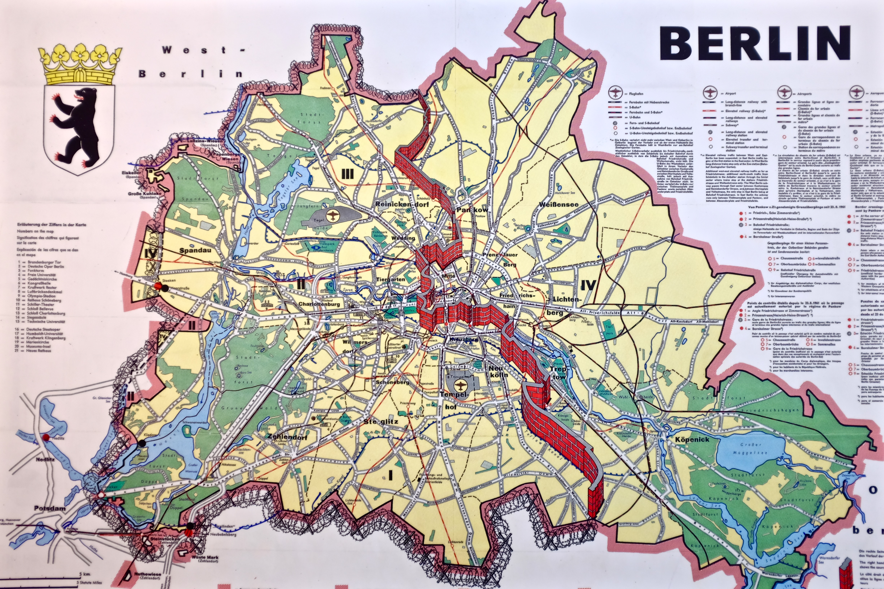
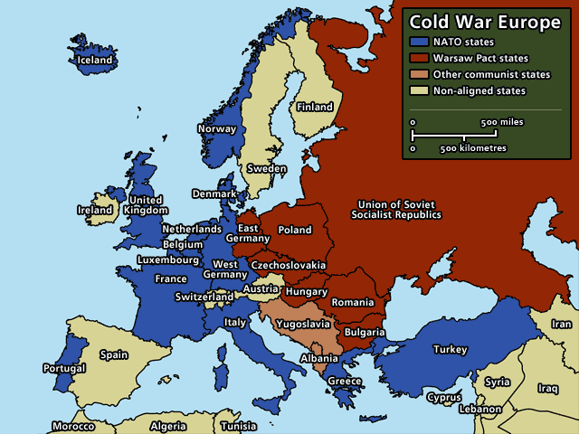
The Fall of the
Berlin Wall, 1989
USSR
USA
Notes:
This again is quite a straight forward one – there are a number of images that take you through key aspects / incidents which will need some explanation.
1). A map showing the division of the world during the Cold War.
2). The Grand Alliance
3). The Berlin Blockade
4). Arms race
5). NATO and The Warsaw Pact
6). The Berlin Wall
7). The Cuban Missile Crisis
8). Star Wars (Strategic Defense Initiative)
9). The fall of the Berlin Wall

Slide 10
GCSE History (Edexcel)
Paper 3
USA – Civil Rights and Vietnam
Notes:
Studied at the end of Year 10 and start of Year 11.

Slide 11
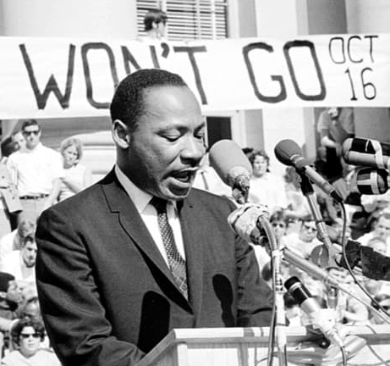
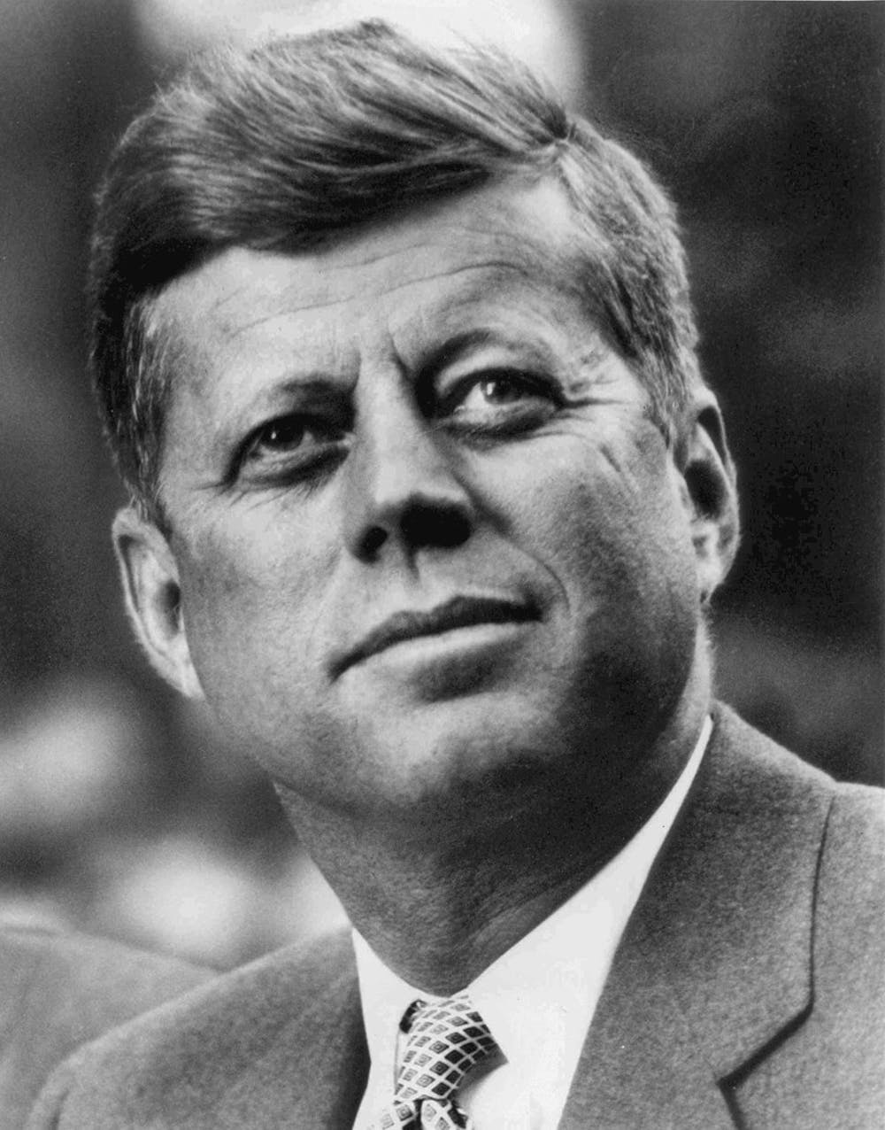
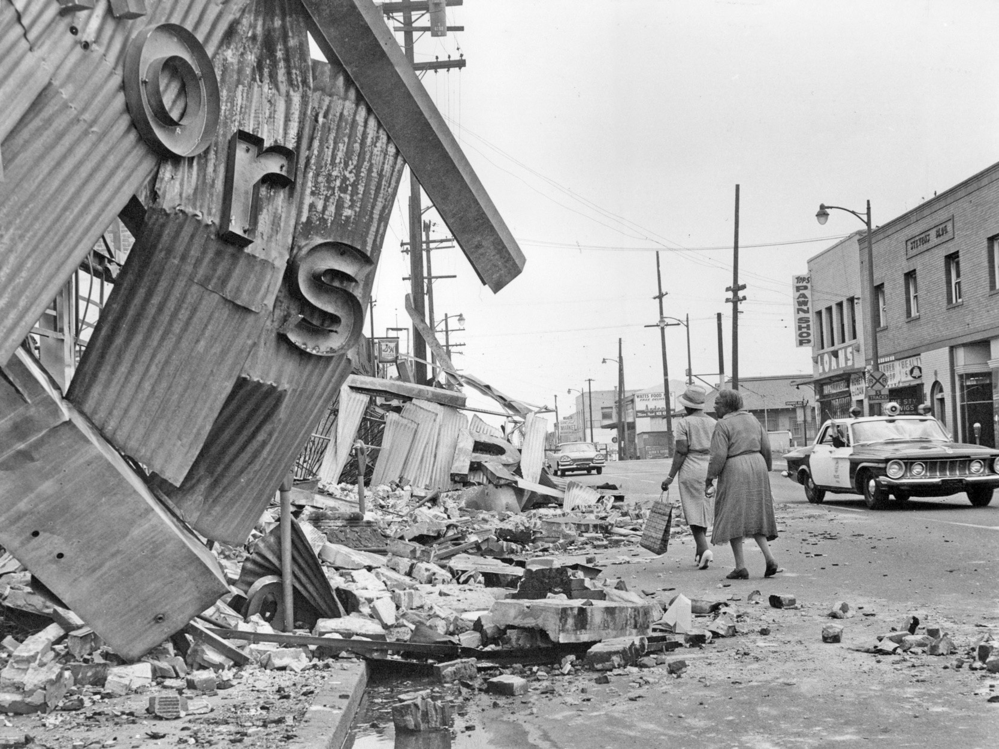
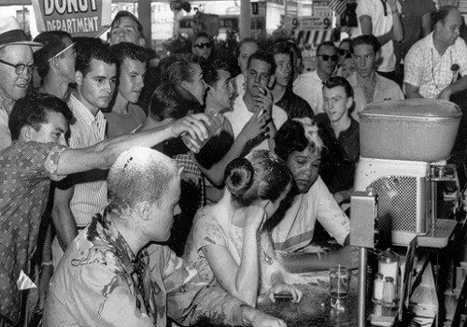
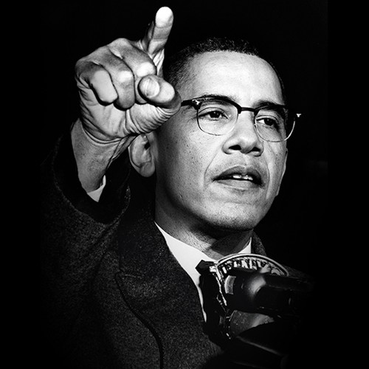
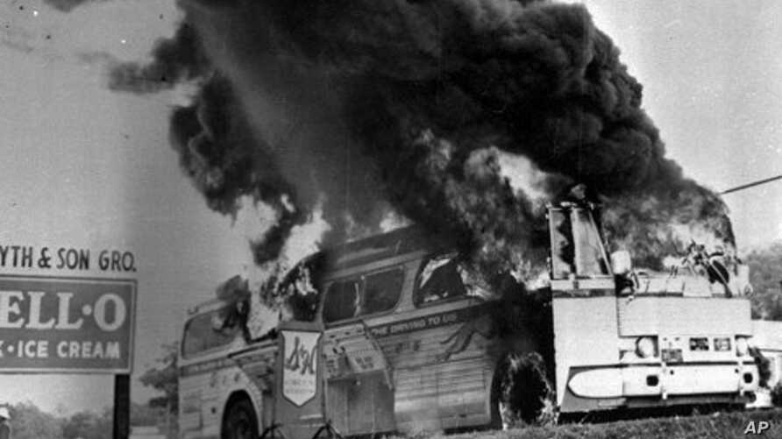
Notes:
A few pictures that need explanation:
1). Martin Luther King
2). Freedom Riders
3). President Kennedy
4). Sit Ins
5). Malcolm X
6). Riots in LA

Slide 12
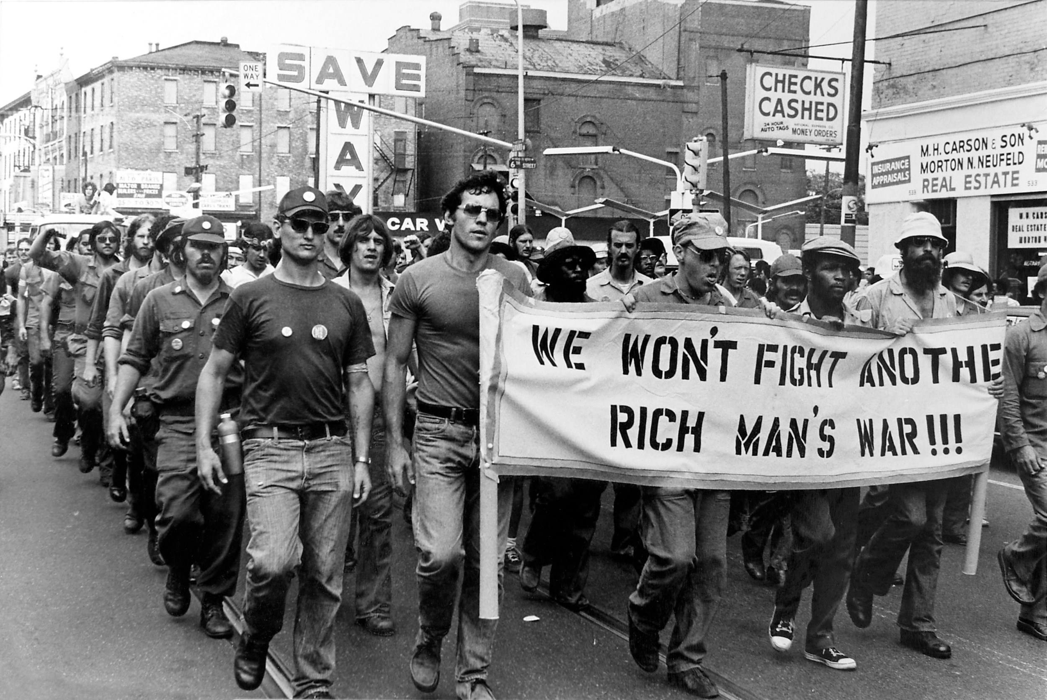
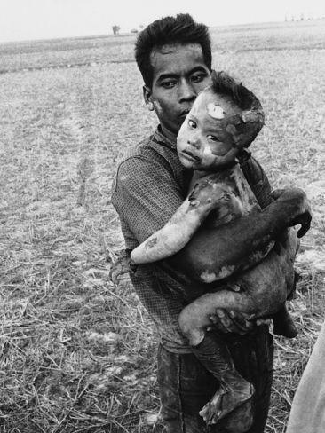
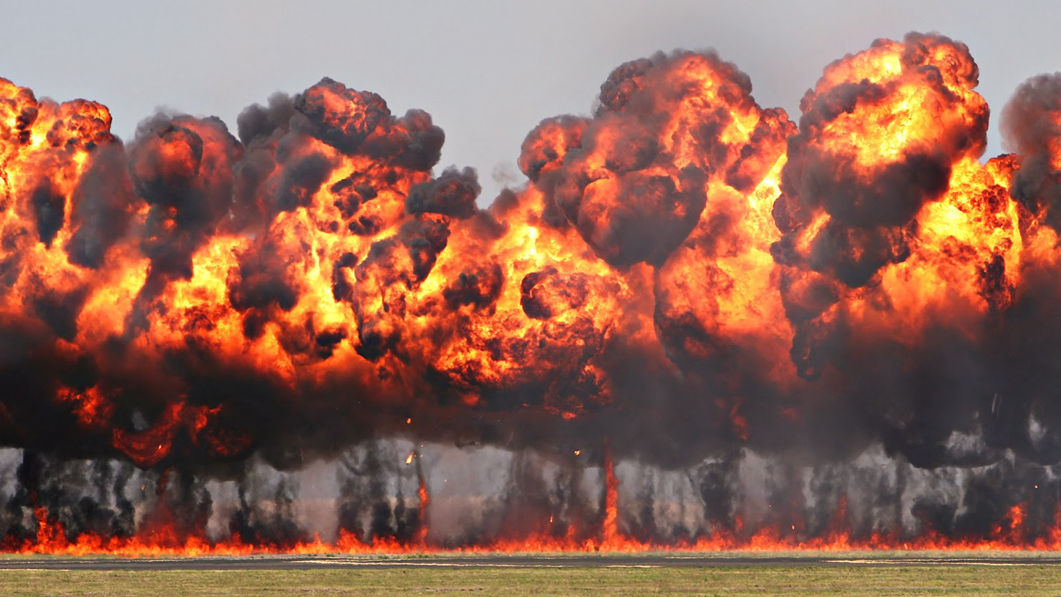
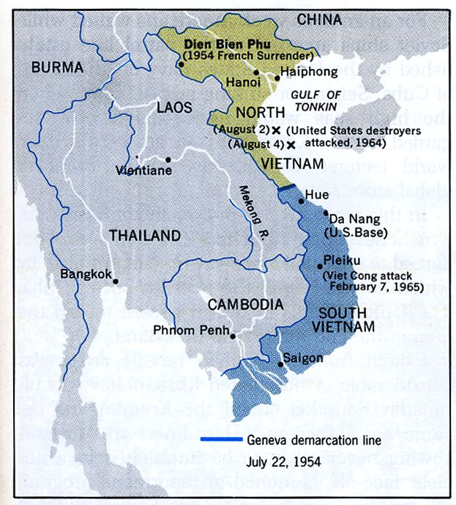
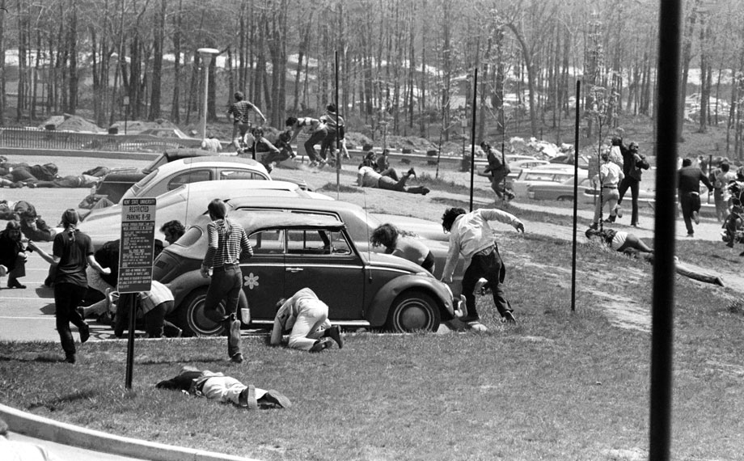
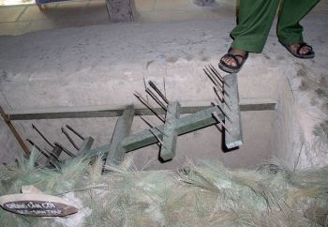
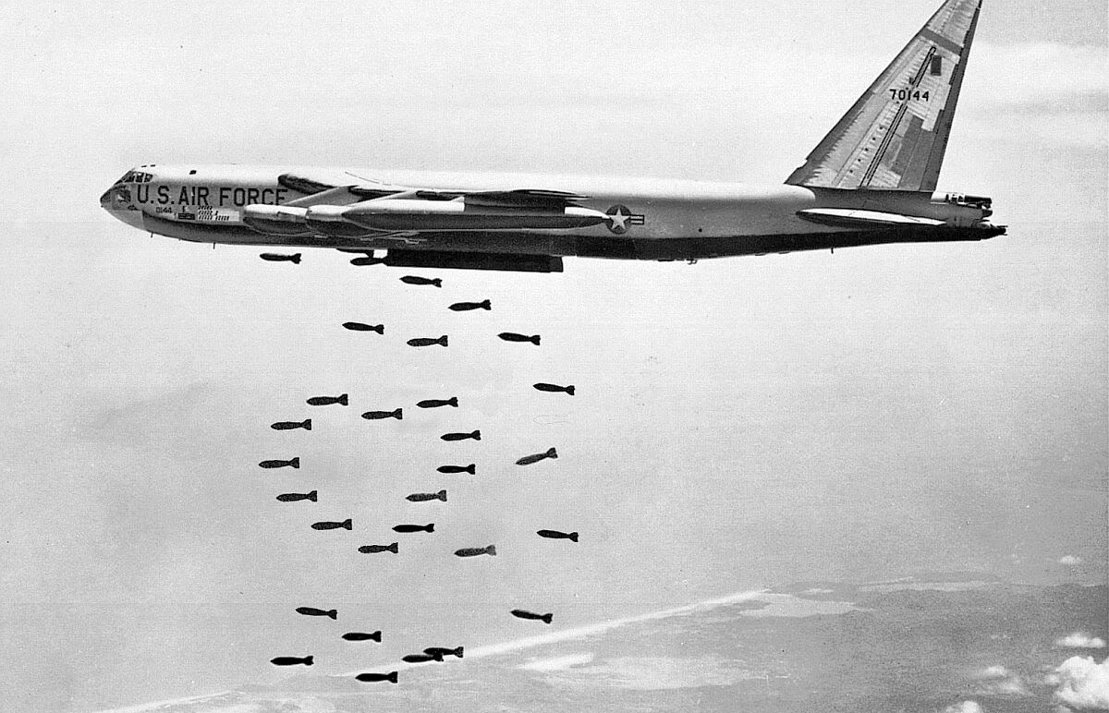
VIETNAM
Studied at the end of Year 10 and start of Year 11.
Notes:
A few pictures to explain and tell the story.
1). Vietnam before the war
2). Rolling Thunder (US tactic)
3). Chemical weapons – Napalm (US tactic)
4). The Impact on the Vietnamese community
5). Booby traps (Vietcong tactics – more detail needed)
6). Protest in the USA
7). Kent State University shooting of students

Slide 13
Pathways for post-16 study
Pupils can go onto to any of the local 6th form providers to study A’ Level History
Post-18 students can progress to a wide range of History degrees at universities both nationally or internationally, or, they may choose to pursue an apprenticeship or go into employment.

Slide 14
For more information about the course,
please speak to your child's history teacher at progress evening on Thursday 14th March 2024.
Notes:
Any questions please ask parents to email me – my address is on the sheet.

